Slide 1

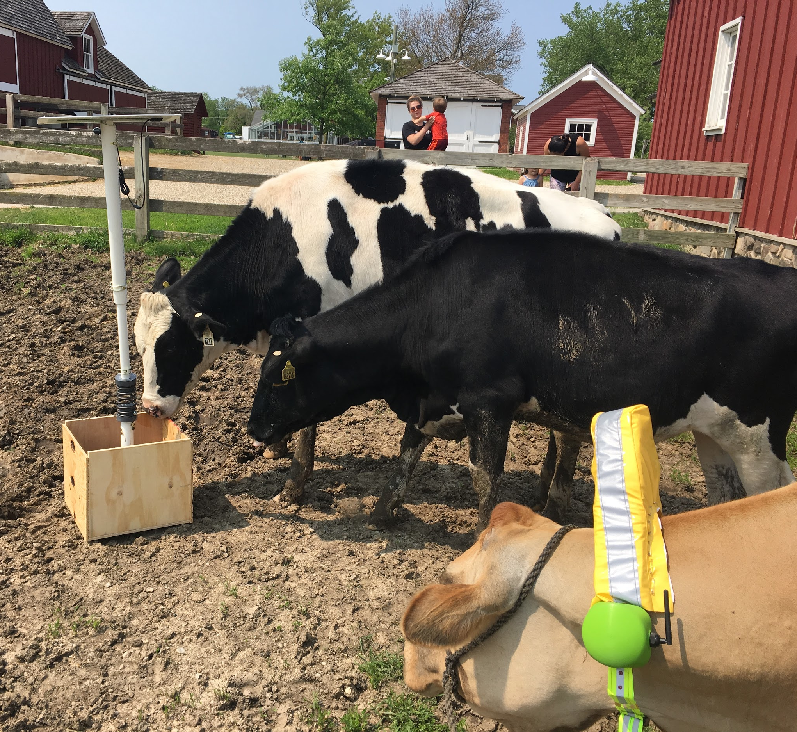
CattleTECH
Natalie Hanson | Maddie Hong | Henry Moskal | Freesoul El Shabazz-Thompson | Ieva Stakvilevičiūtė
June 8, 2019
DSGN 384-2
Notes:
Henry

Slide 2
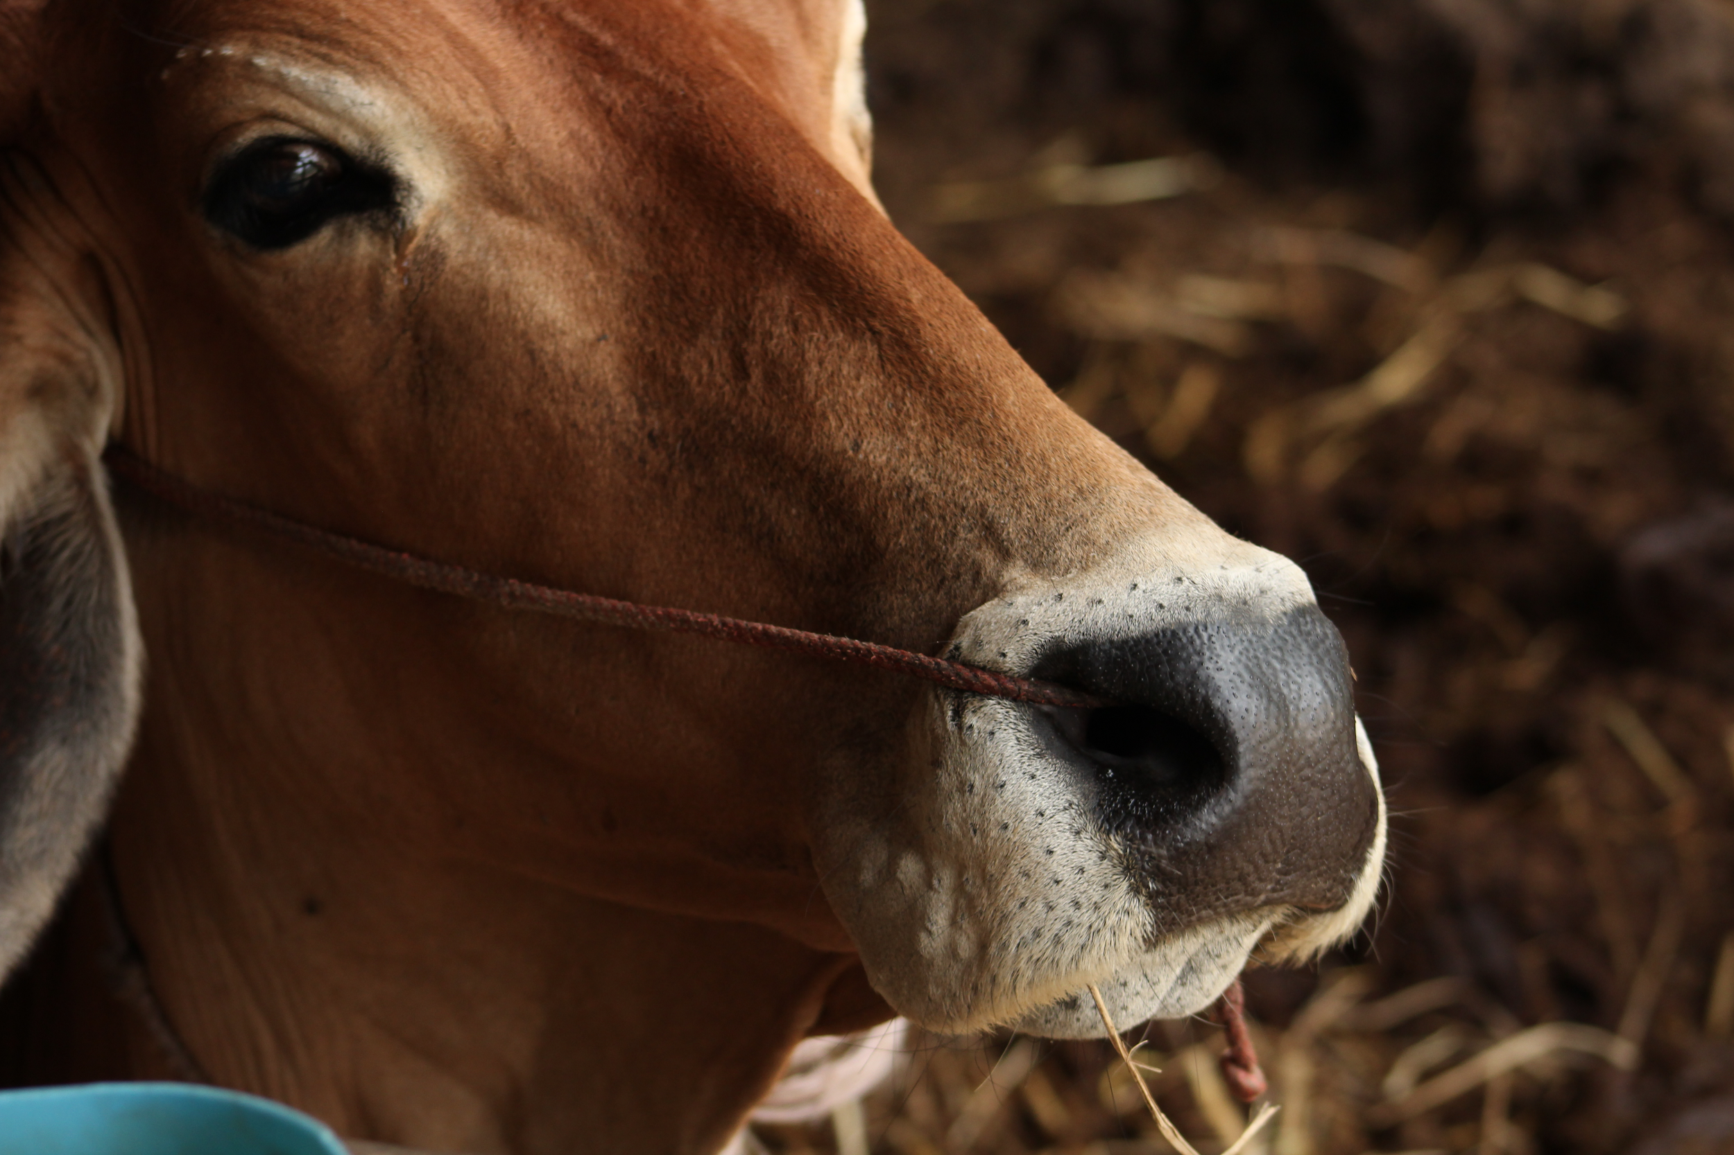
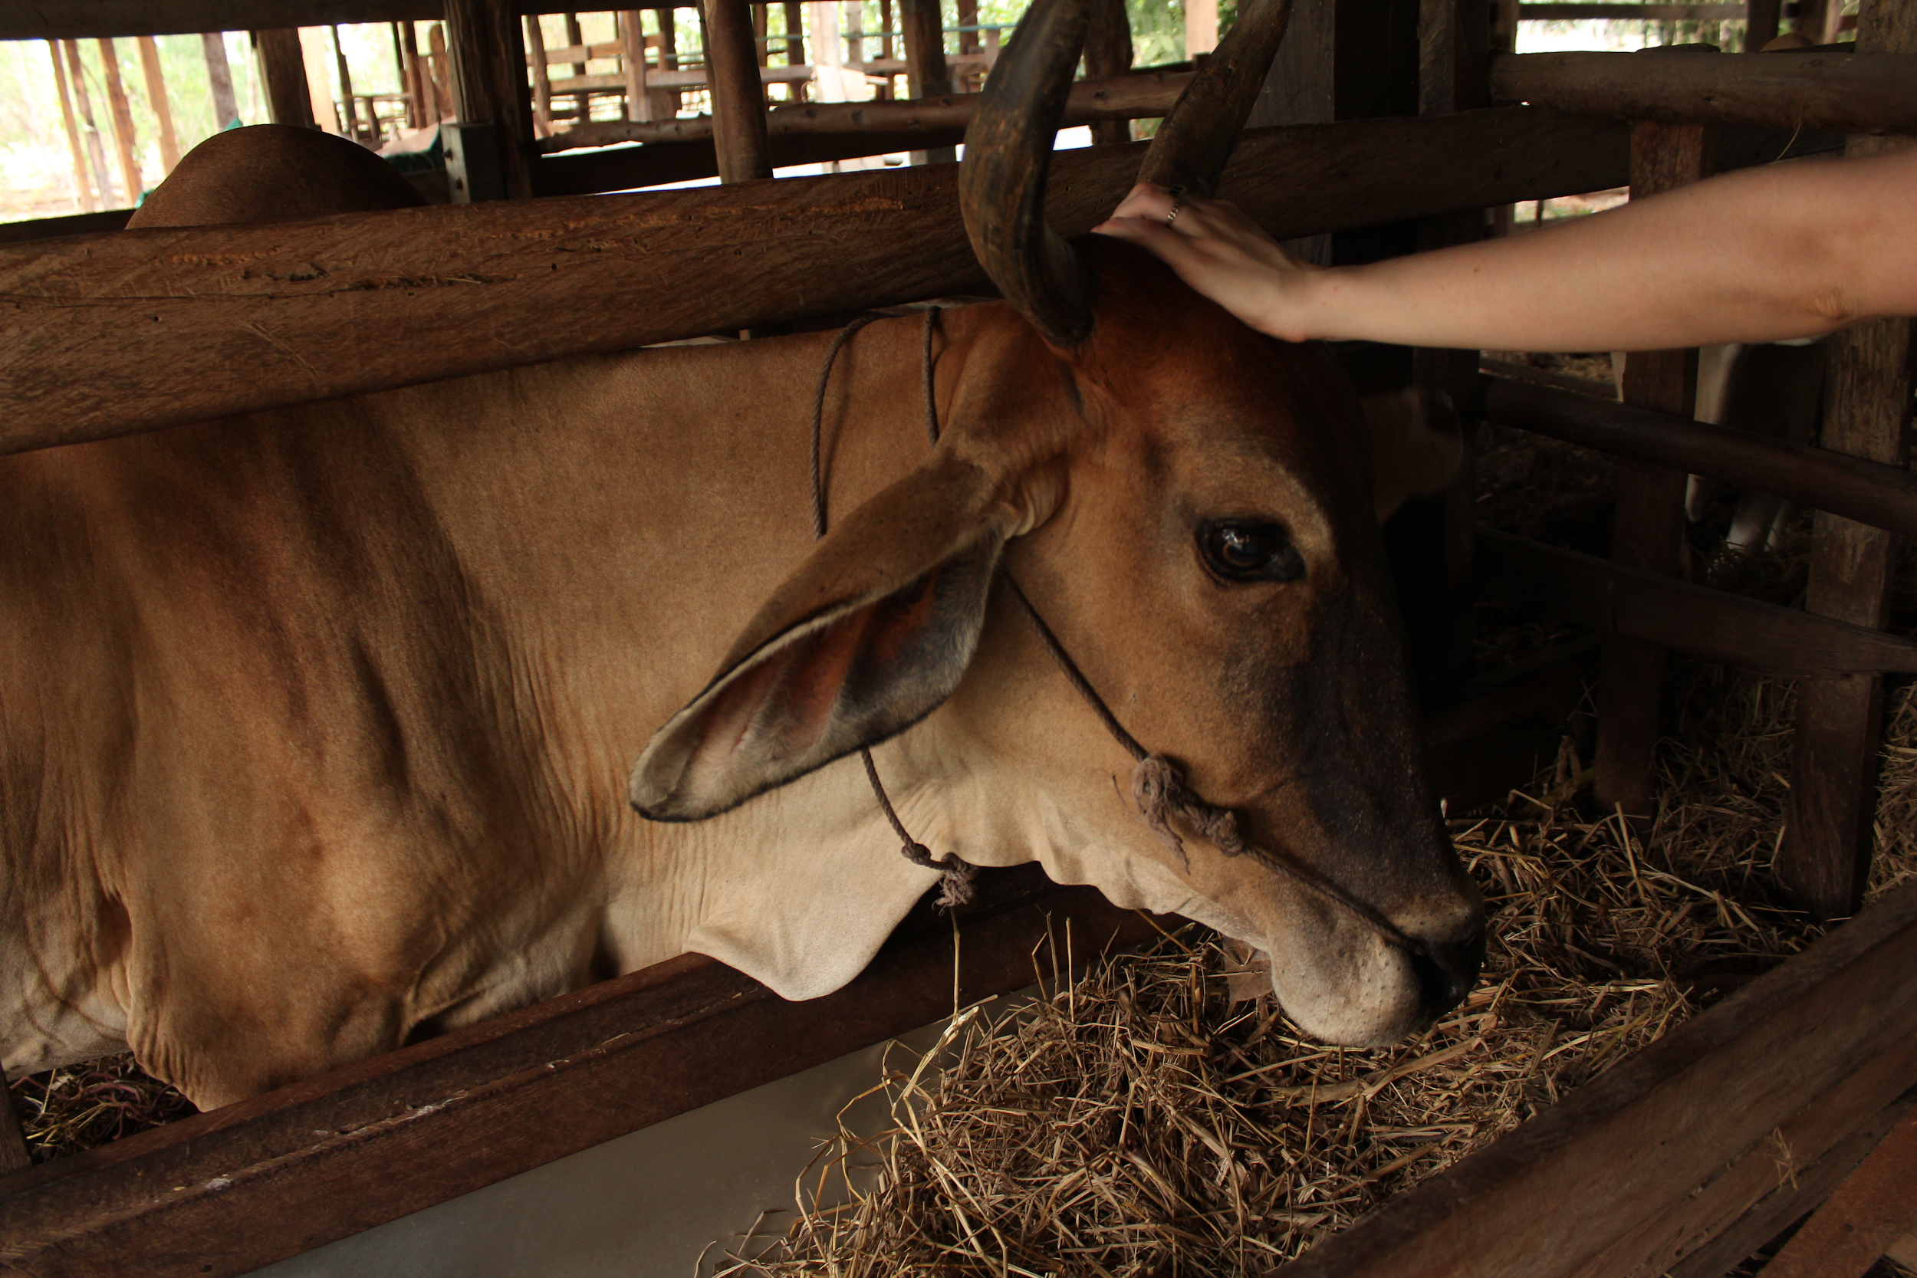
Design Problem Background
Notes:
Henry

Slide 3
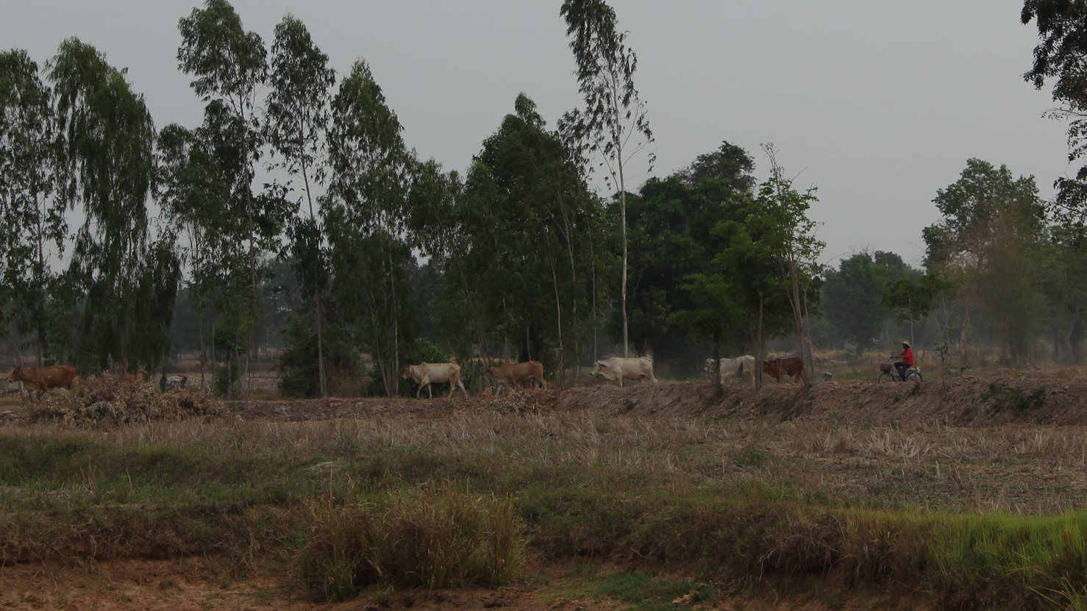
Design Problem Background
Notes:
Henry

Slide 4
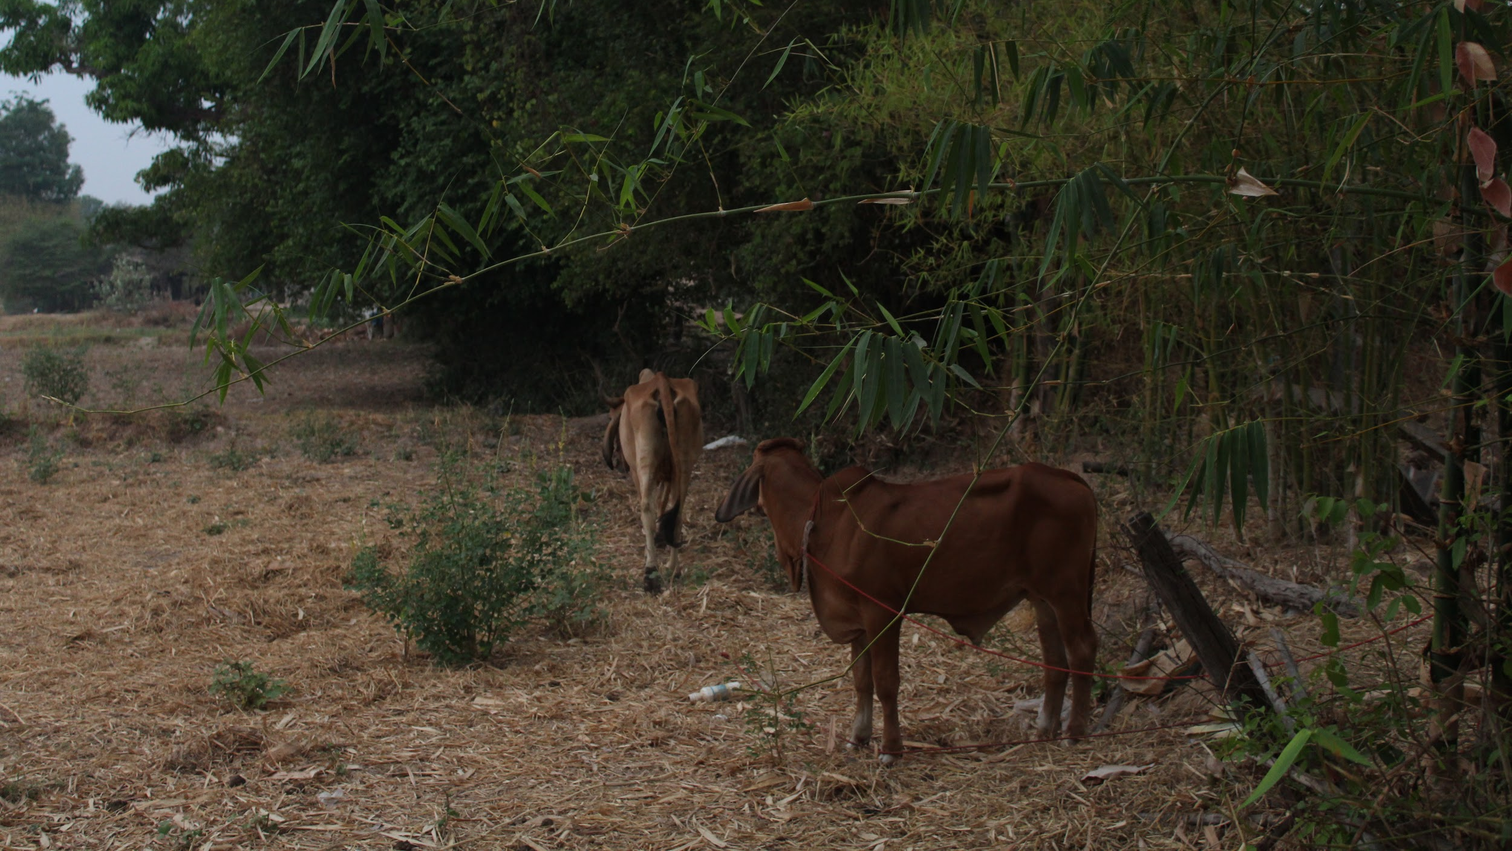
Design Problem Background
Notes:
Henry

Slide 5
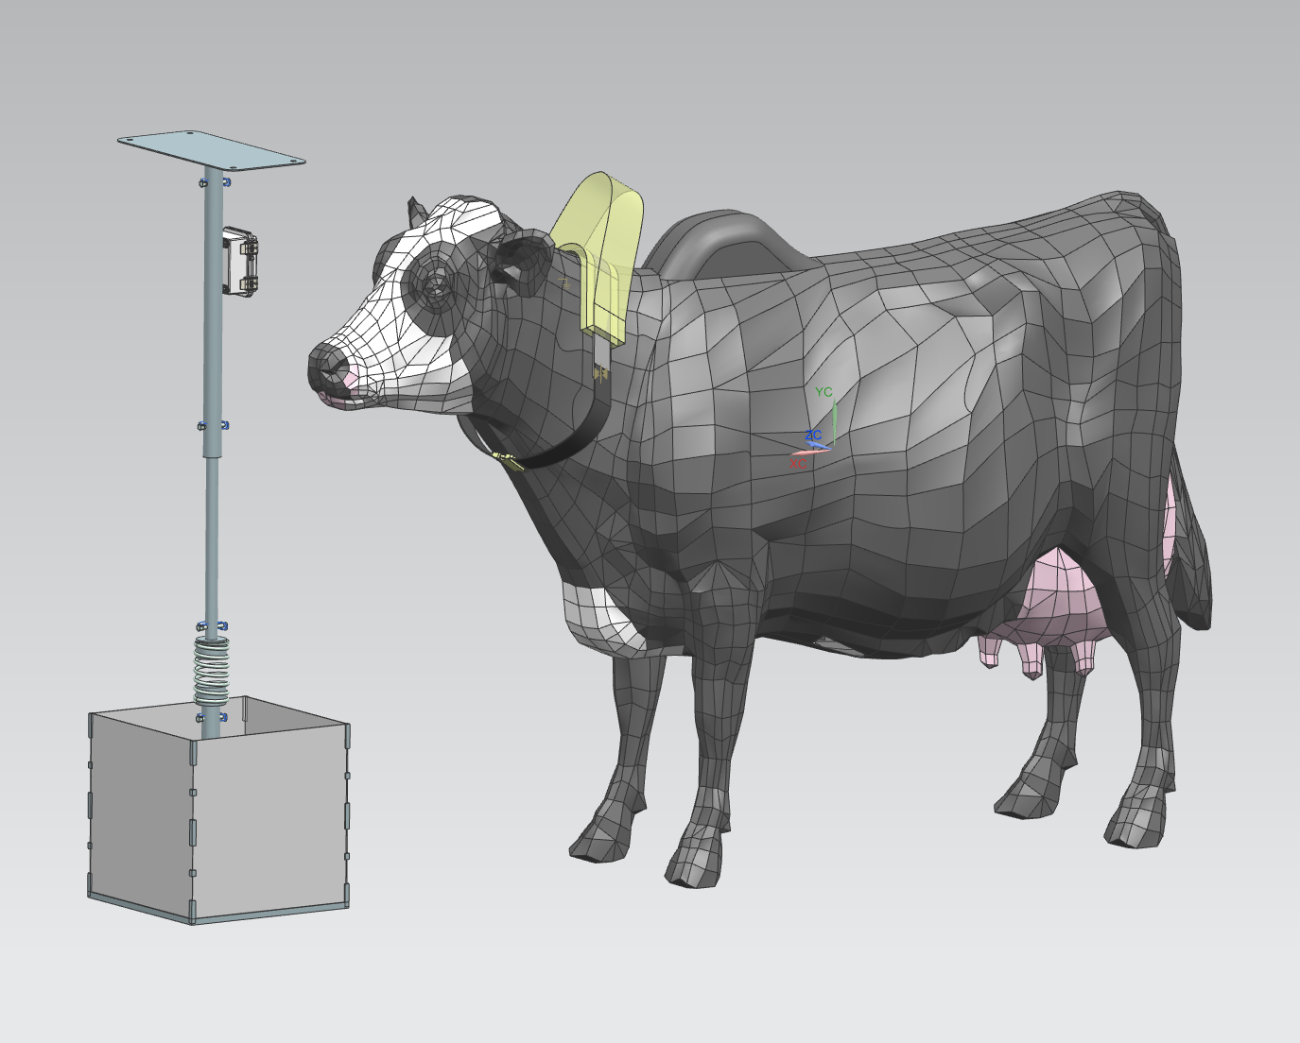
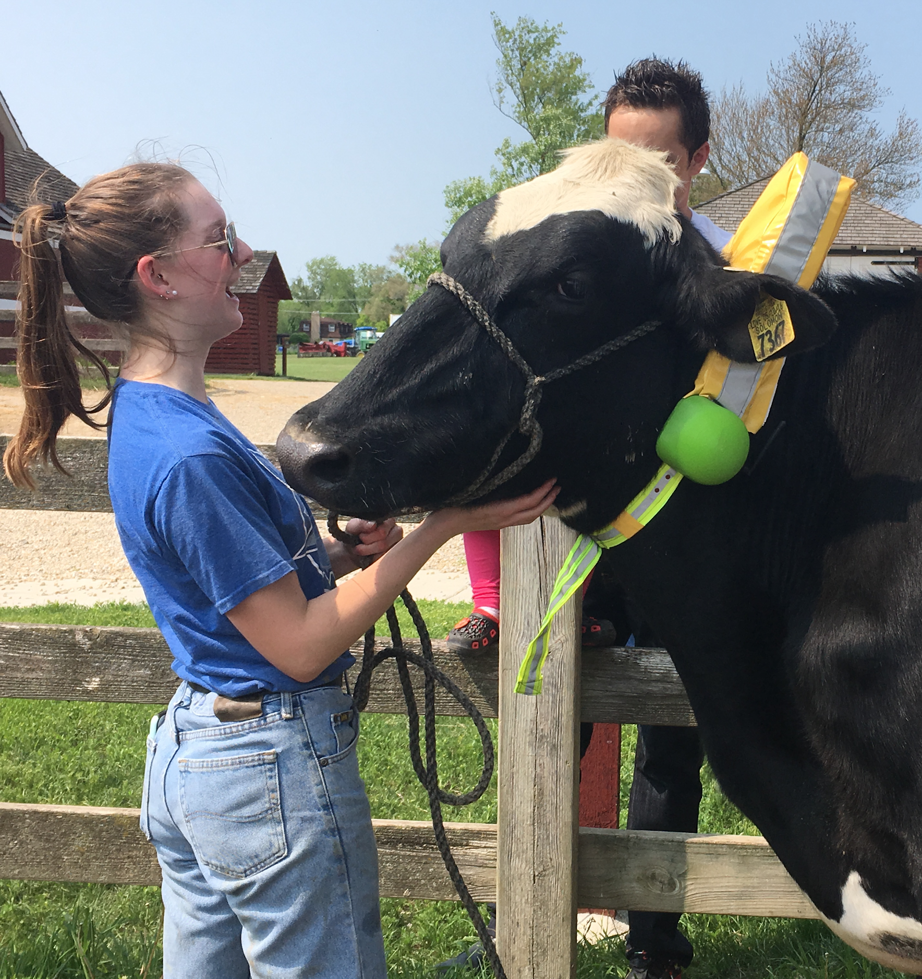
Current Design
Notes:
Henry
High vis collar that interfaces with a central post to virtually fence cattle

Slide 6
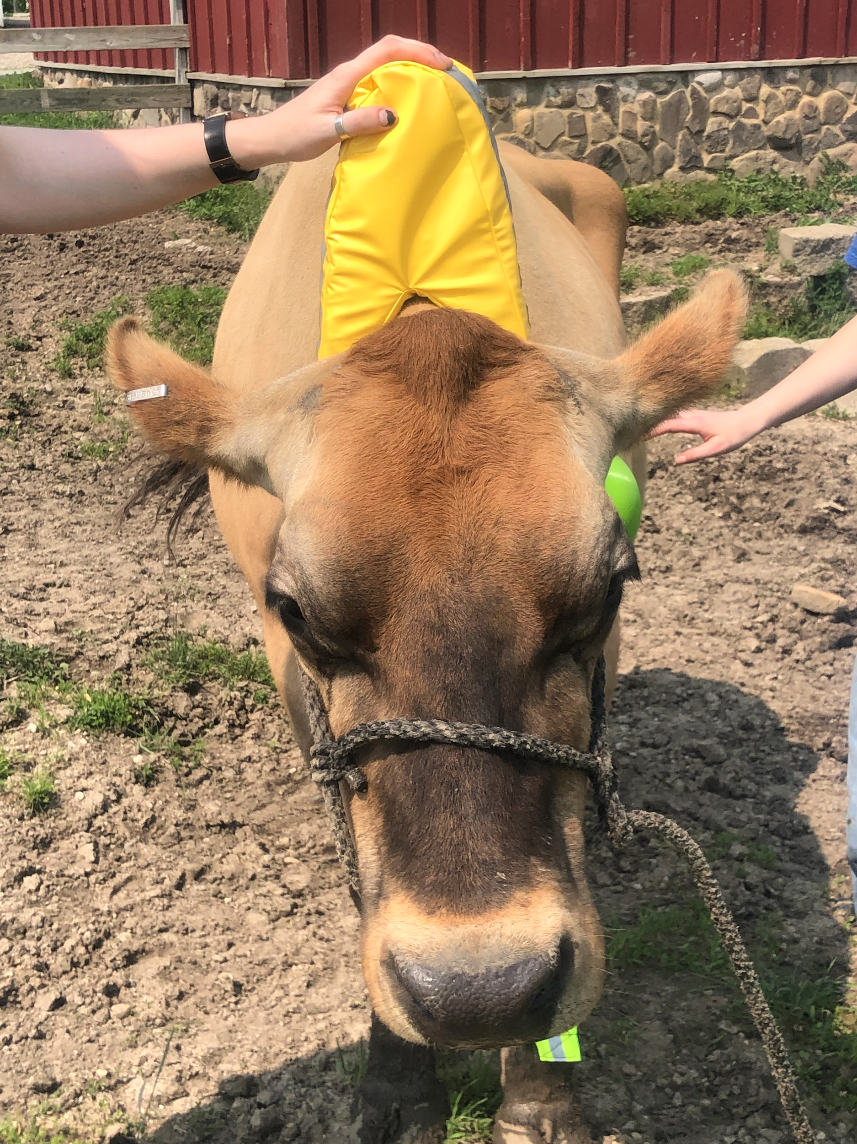
Visibility Components
Shape customized to Thai Brahman hybrid cattle anatomy
Waterproof casing around a light open-cell foam with an aluminum skeleton
Sewn with highly reflective strips and adjustable straps
Detachable housing for modular options
Notes:
Henry

Slide 7
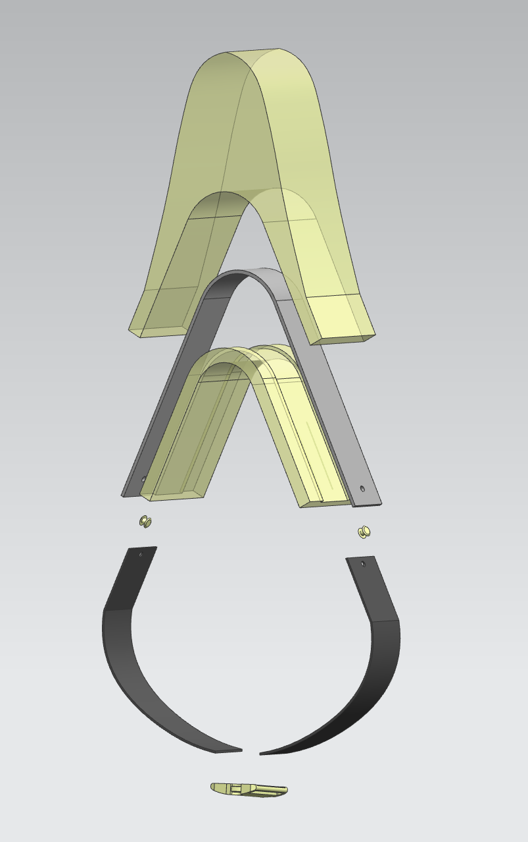
Castable foam exterior and interior. PE coating.
Metal spine structure
Electronics housing mounted on metal
Screws
Fabric Rivets
Adjustable reflective
fabric strap mounted
on metal
Cam Buckle solves stability and Contact challenges
‹#›
Notes:
Ieva

Slide 8
Software Components
Two-part communication system via radio signal strength
Collar
Internal distance measuring system
Connected to 1 post at a time
Constant receiving (when not in sleep mode)
Transmitting based on distance
Post
Connected to up to 10 cattle at a time
Constant transmitting w/ variable intervals
Notes:
Natalie

Slide 9




Diagram of system
Repel
1 rai
Contain
Notes:
Natalie
Collar determines position in relation to post using RF signal strength. If the cattle is approaching a boundary, sound and then shock feedback occurs to return the cattle to its herd.

Slide 10
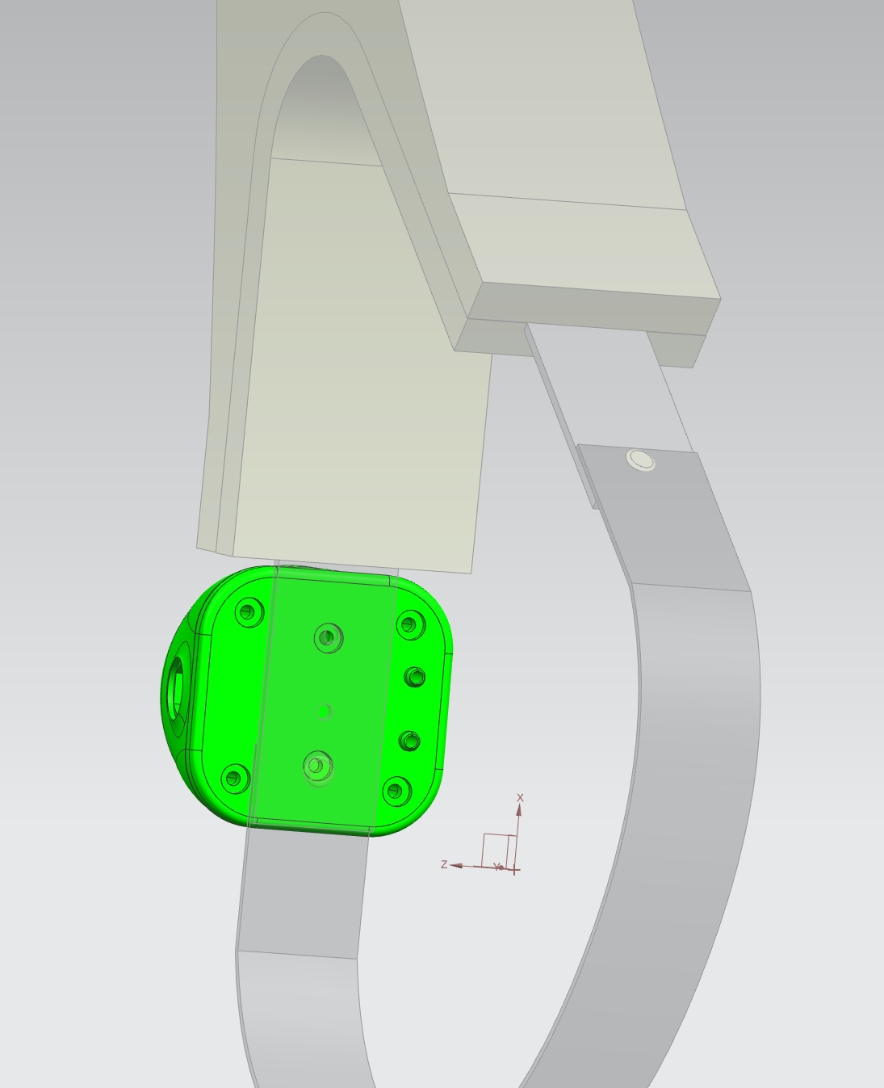
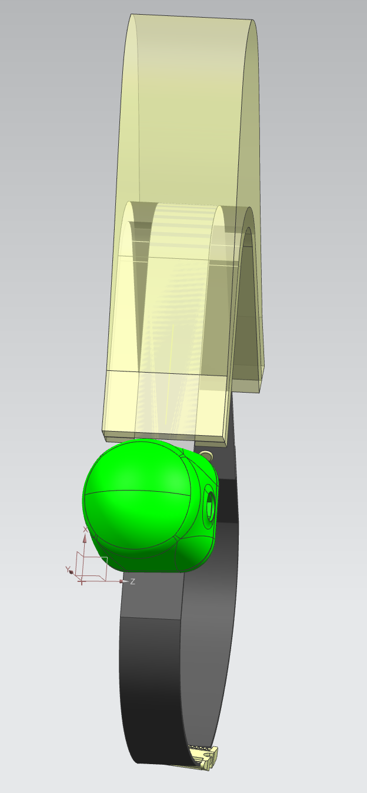
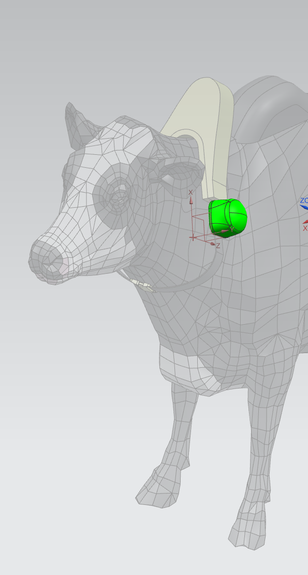
Electronics housing
Notes:
Freesoul

Slide 11
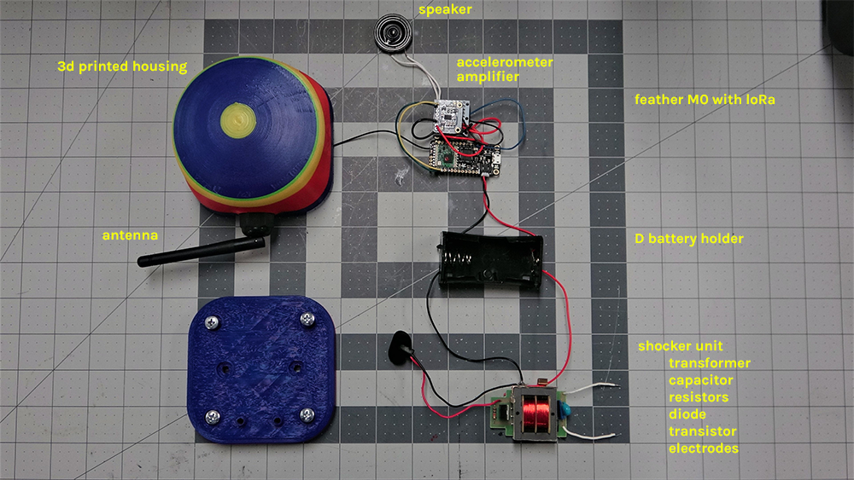
Notes:
Freesoul

Slide 12
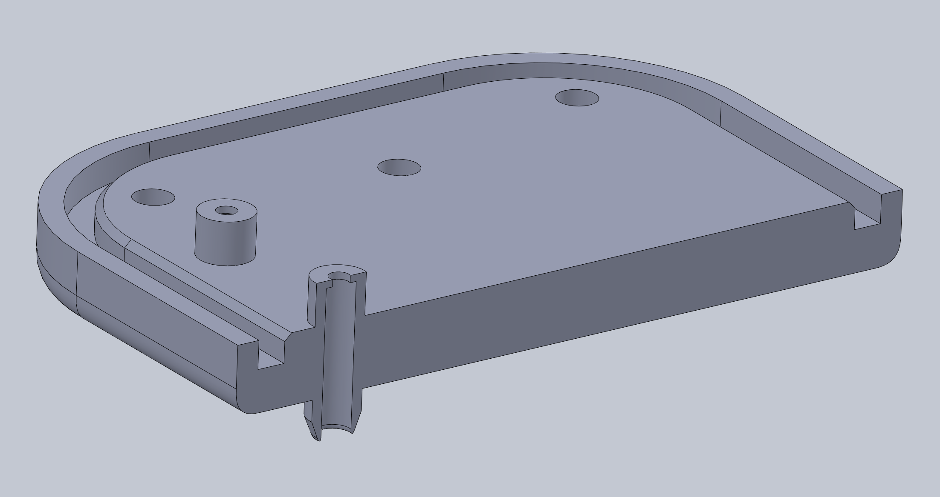

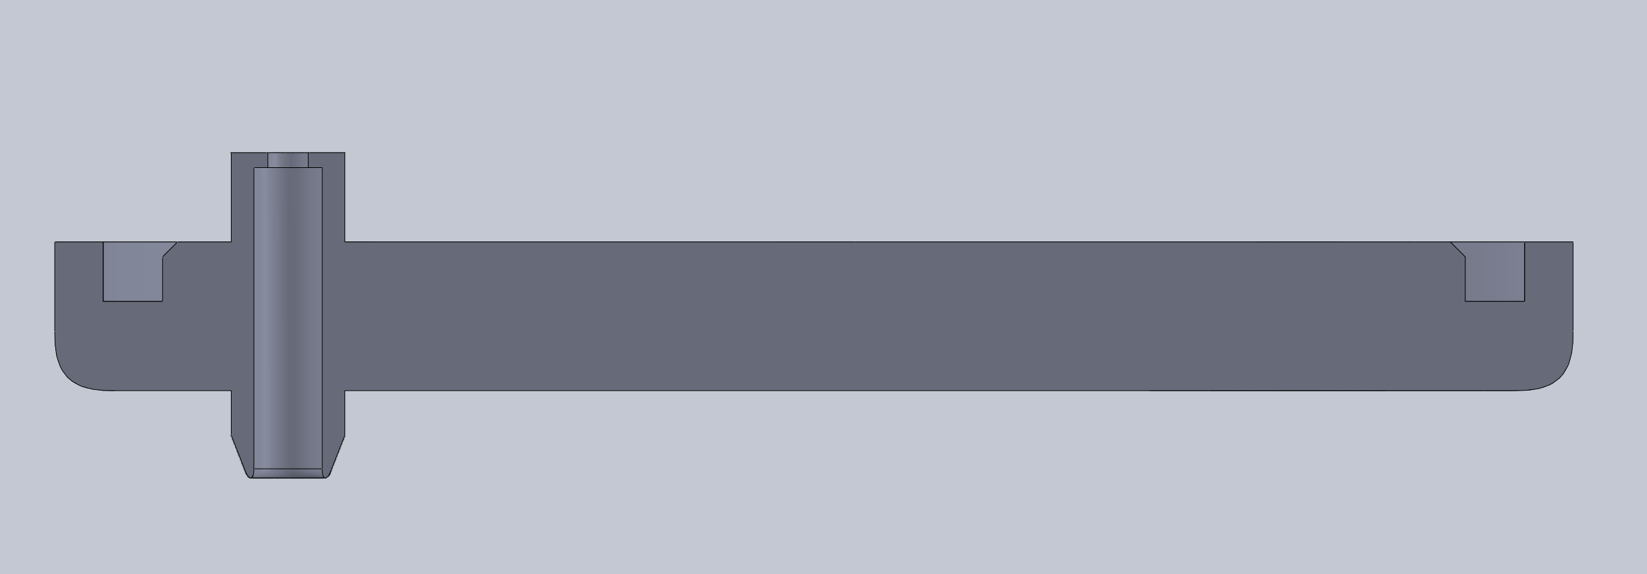
Notes:
Physical housing design

Slide 13
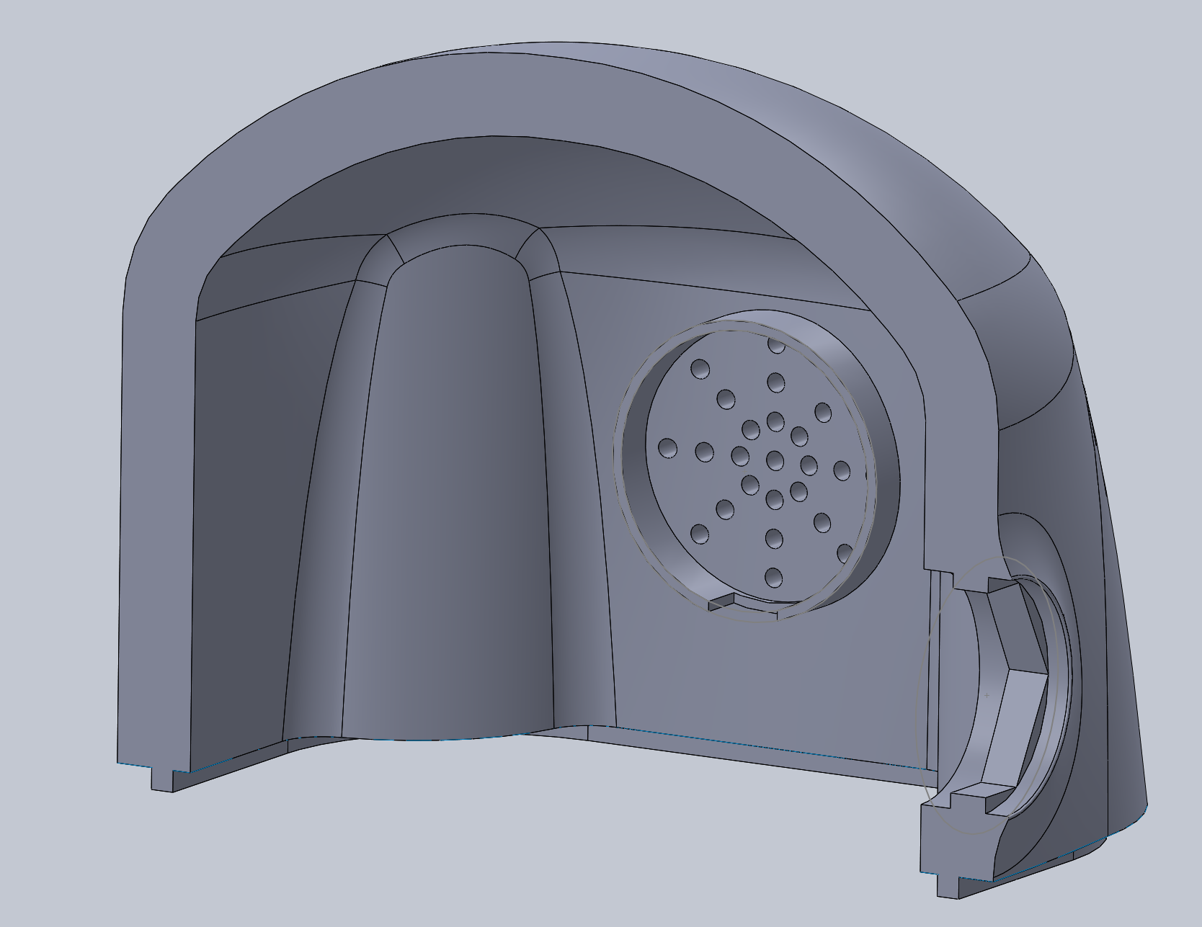
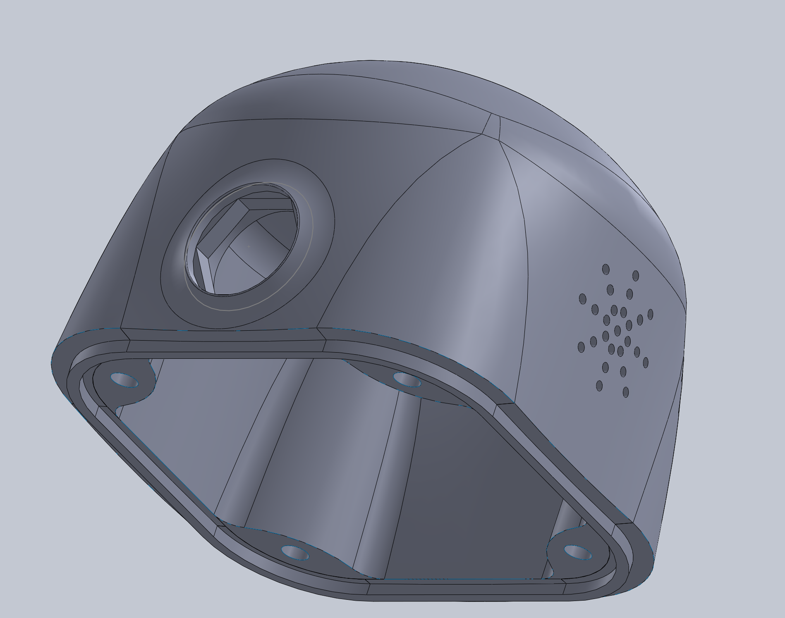
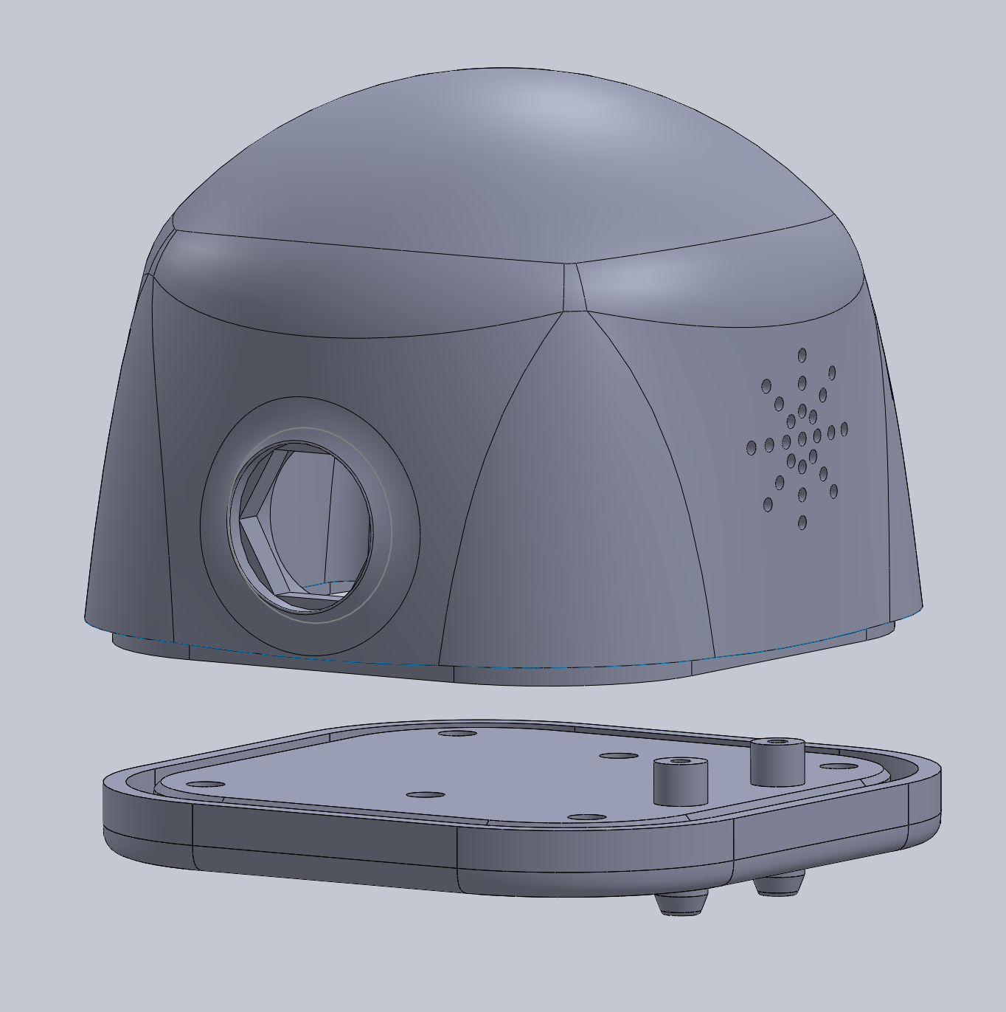
Notes:
In order to bring this concept into full fidelity:
injection molding, silicon sealing of edges, epoxy insulation, single pcb build

Slide 14
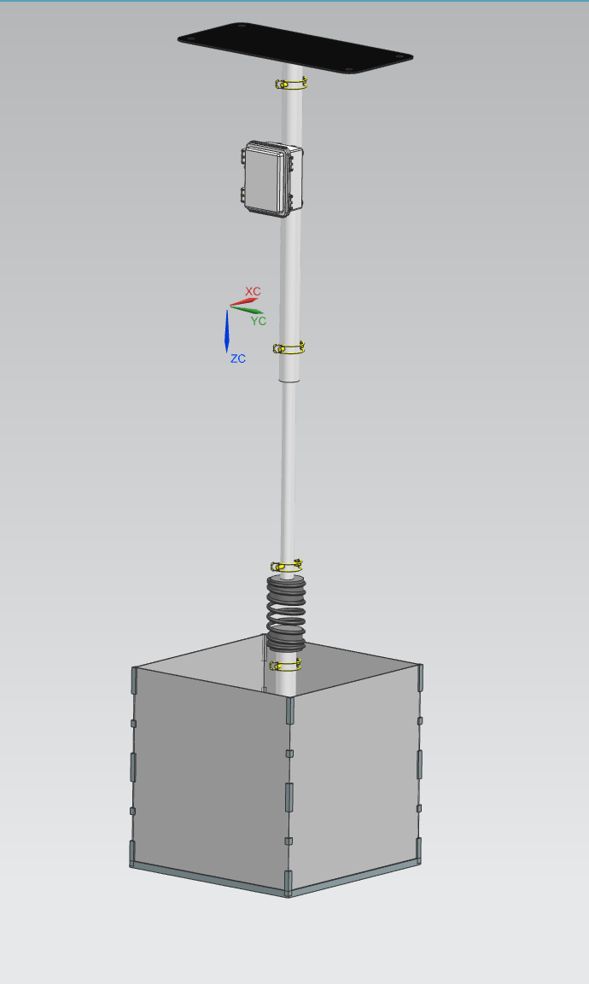
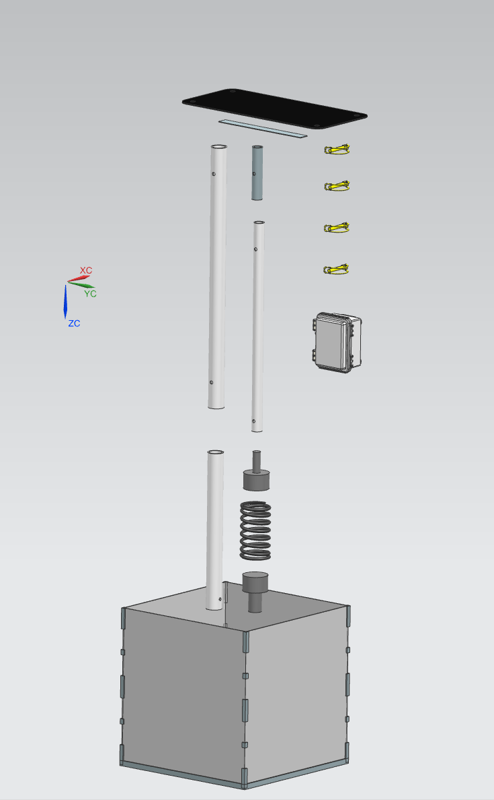
Post
Flexible Solar Panel
VHB tape
Collapsing PVC tubes
Telescoping rod pins
Electronics Box
Spring Plugs
Spring
PE box with Aluminium frame
60 inches
Notes:
Ieva
Height- 60”
Box - Outdoor NEMA Enclosures
Attachment - Metal zip ties

Slide 15


Slide 16
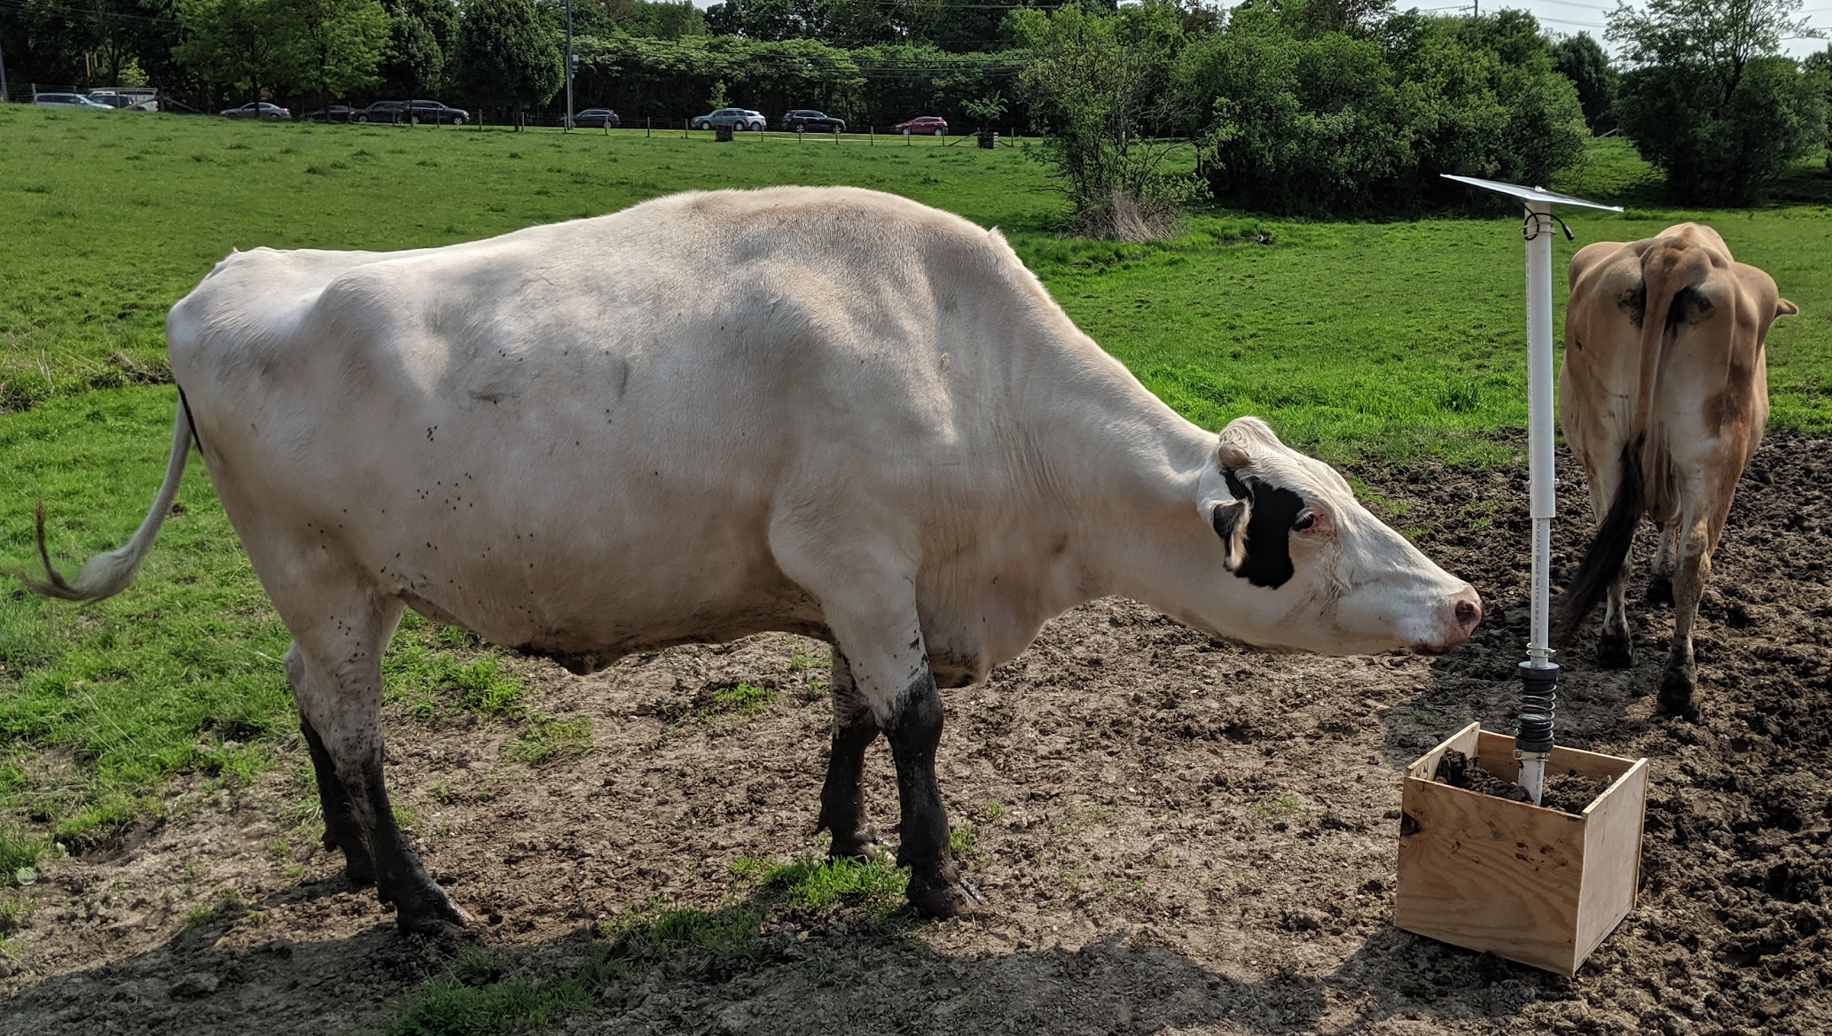
Post hardware
Flexible solar cells | 12V, 25 Watt
Feather MO Lora | 433 MHz, ~40mA draw
Lithium ion battery | 3.7V, 6600mAh
Antenna | 433 MHz, 15 cm long
Push buttons (2) | 12V, operating 3A
LED (3) | 12V
Notes:
Ieva

Slide 17
Sending to Thailand
Project next steps
Two visibility prototypes
Detailed manufacturing process for collars and post
Hackster page with all of the code for download
Upgrading the hardware for more accurate signal strength detection
Using multiple posts for triangularization of cattle
Using a closed-cell foam
Testing shock feedback
Notes:
Freesoul

Slide 18
Thank you! Questions?

